Slide 1
GAMING STRATEGY
IDS Project Presentation under session
Aug 2019 - Dec 2019
Guide: Prof. Jamuna S Murthy(Assistant Professor)
Dept of CSE, PESU
PES1201801468 - Shriya Raikar
PES1201801 979 - Pallavi S Murthy
PEs1201802033 - Yukthi G L

Slide 2
CONTENTS
Introduction
Aim
Details of dataset and tools used
Data Cleaning
Graph Visualization
Hypothesis Testing
Correlation
Analysis

Slide 3
INTRODUCTION
A game is a structured form of play, usually undertaken for enjoyment and sometimes used as an educational tool.
Games are distinct from work, which is usually carried out for remuneration, and from art, which is more often an expression of aesthetic or ideological elements.

Slide 4

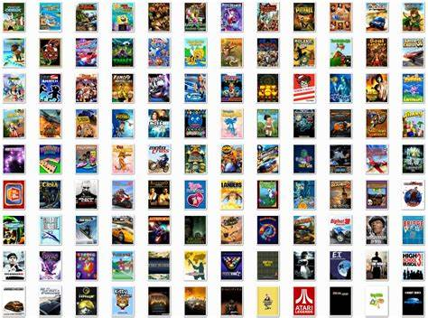
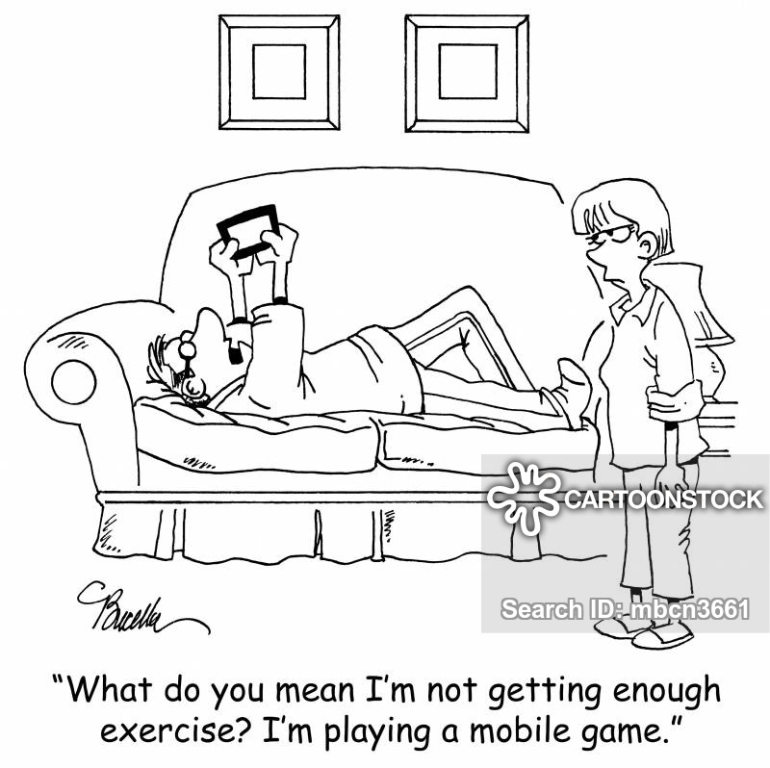

Slide 5
AIM
Games developed are of which purpose?
Are games free of cost?
Most preferable language used?
For what ages ?

Slide 6
Details of dataset and Tools used
Dataset consist of different games.
It consists of 17007 entries with 18 columns.
The columns are : URL, Icon URL, Id, Name, Subtitle, Price, User rating count, Average user rating count, In app purchases, Description, developer, Age rating, original and current version release date, languages, Size, genre ,primary genre.
It also consists of Na values in specific columns.
R and python is used.

Slide 7
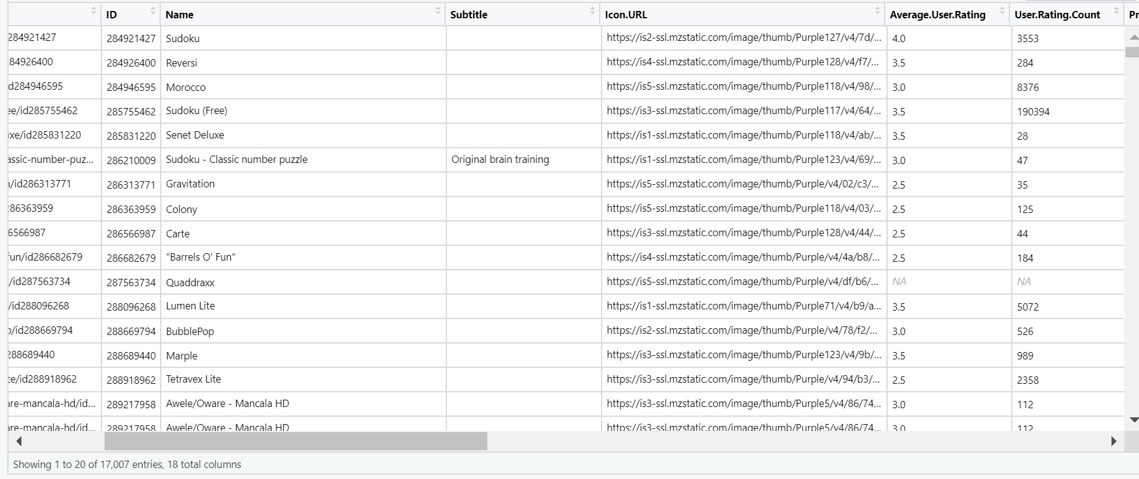
DATA CLEANING
DATASET BEFORE CLEANING IT

Slide 8
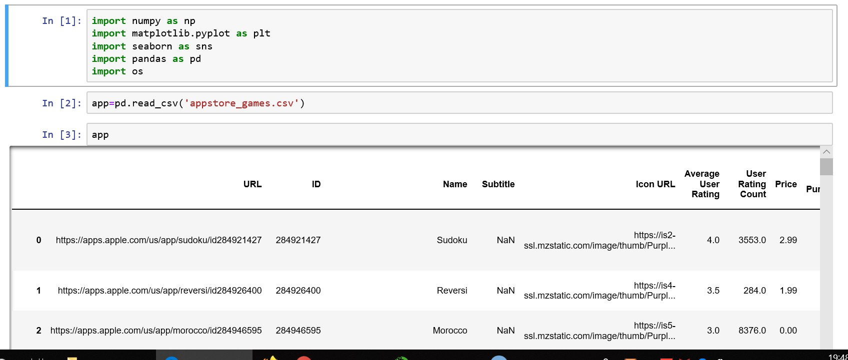

Slide 9
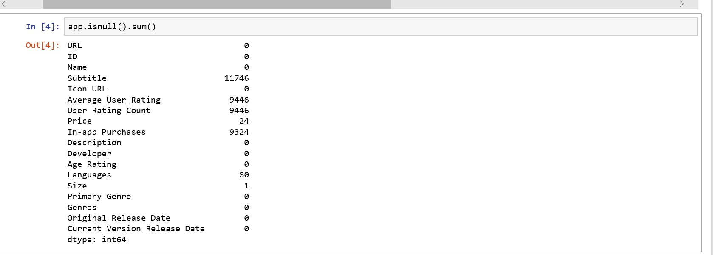
Number of Na values in particular columns

Slide 10
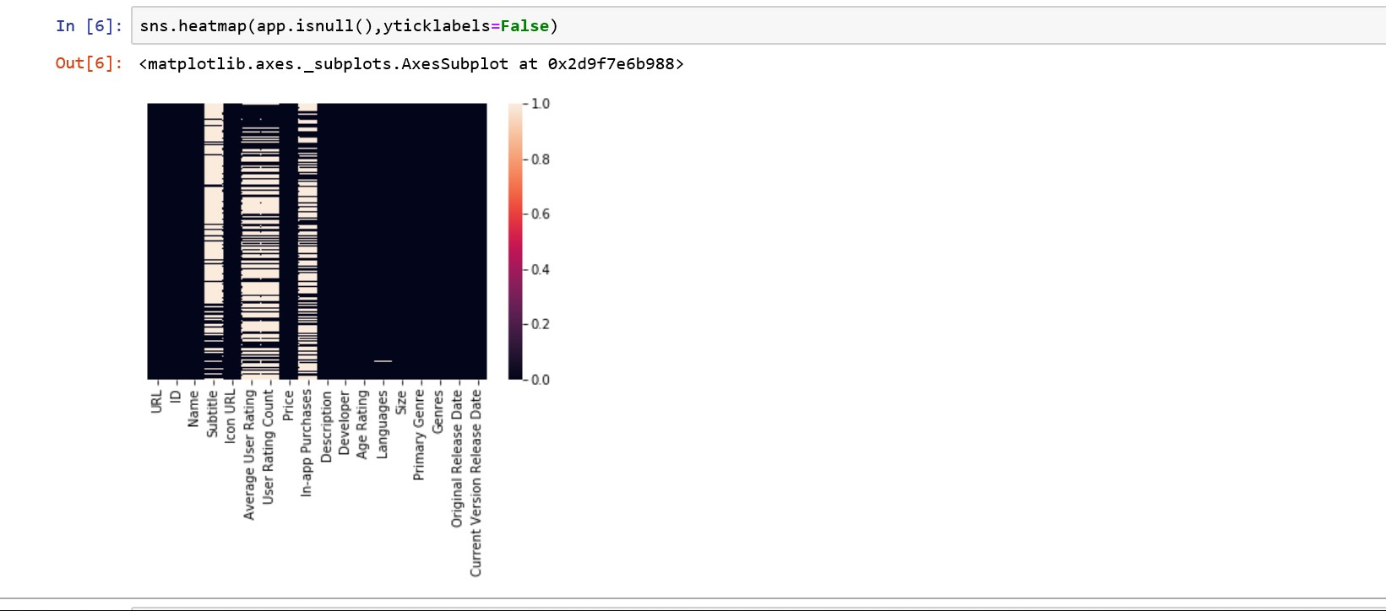
Plot that shows the na values in the dataset

Slide 11
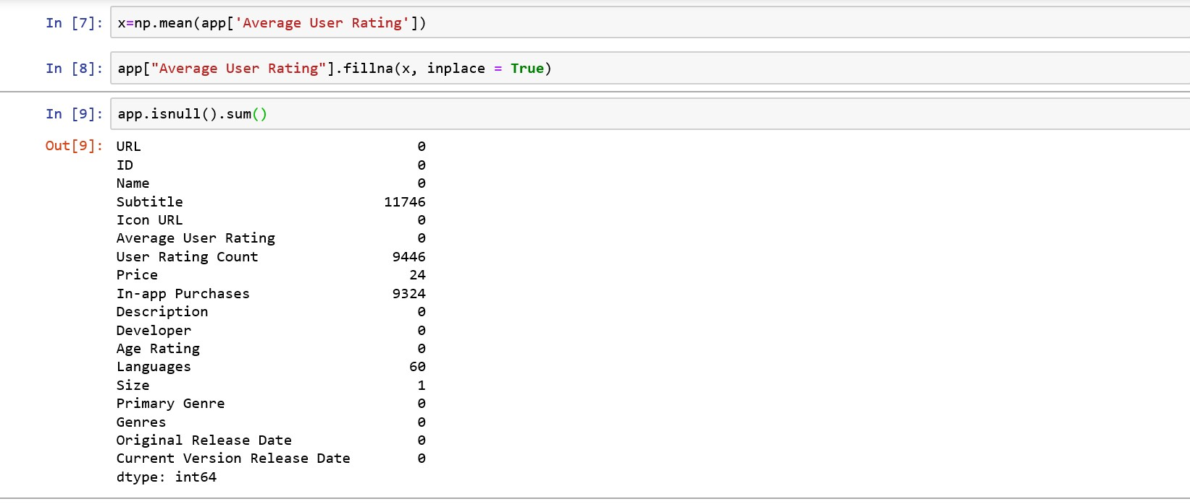
Dealing with na values

Slide 12
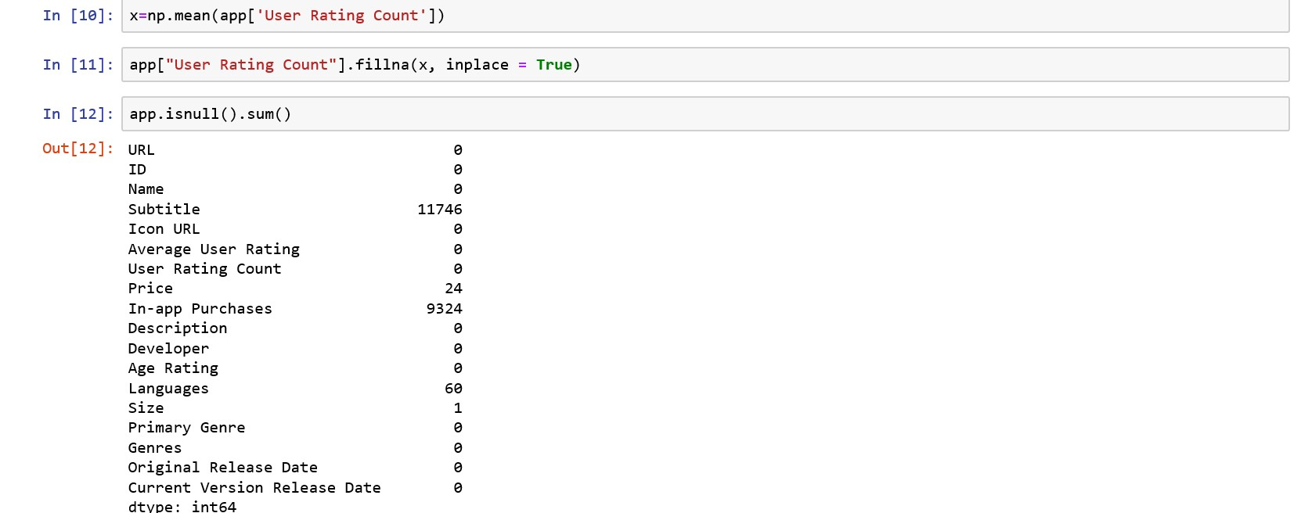

Slide 13
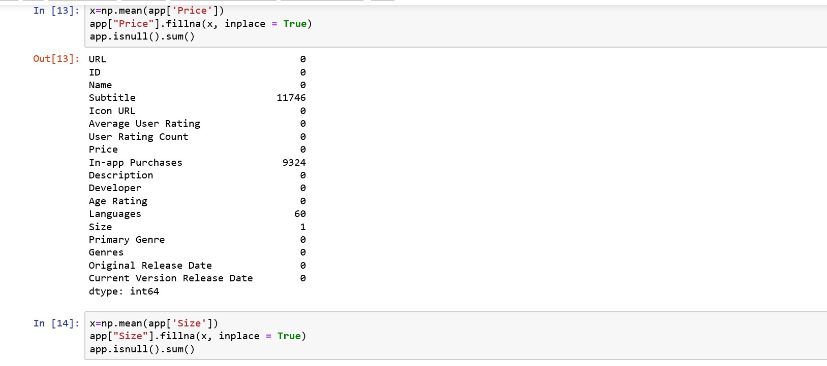

Slide 14
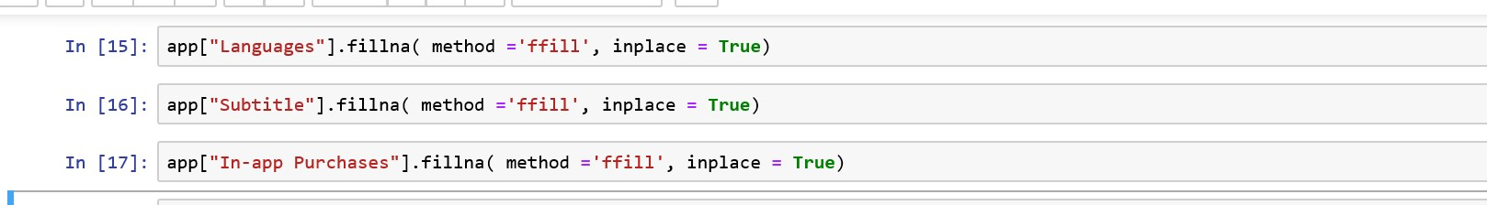
Na values in categorical columns

Slide 15
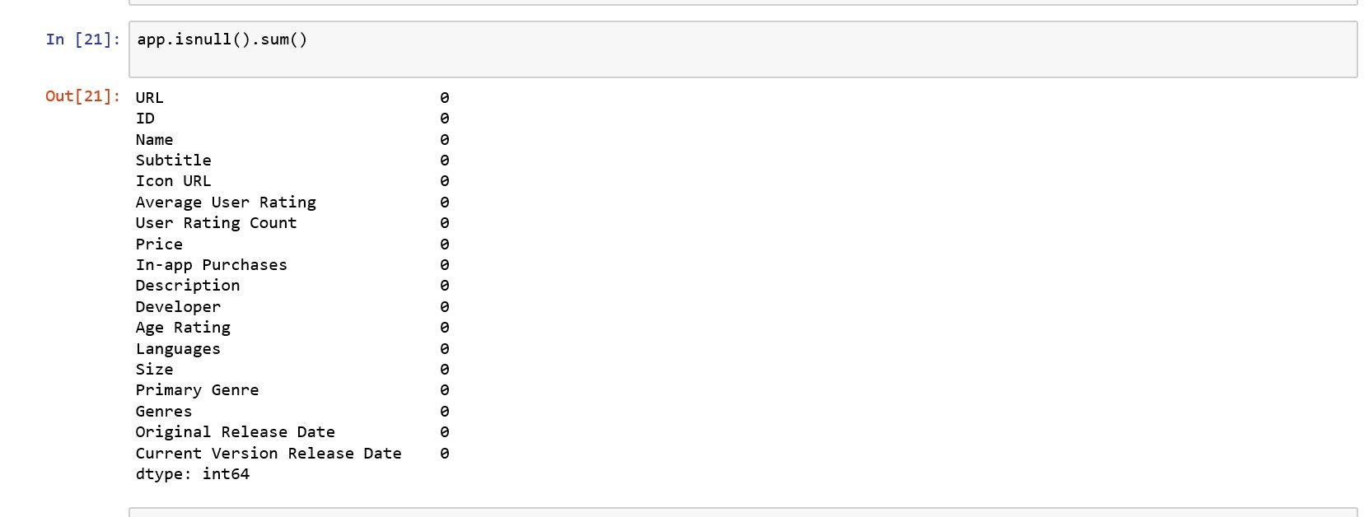
Cleaned Dataset - All na values are removed

Slide 16
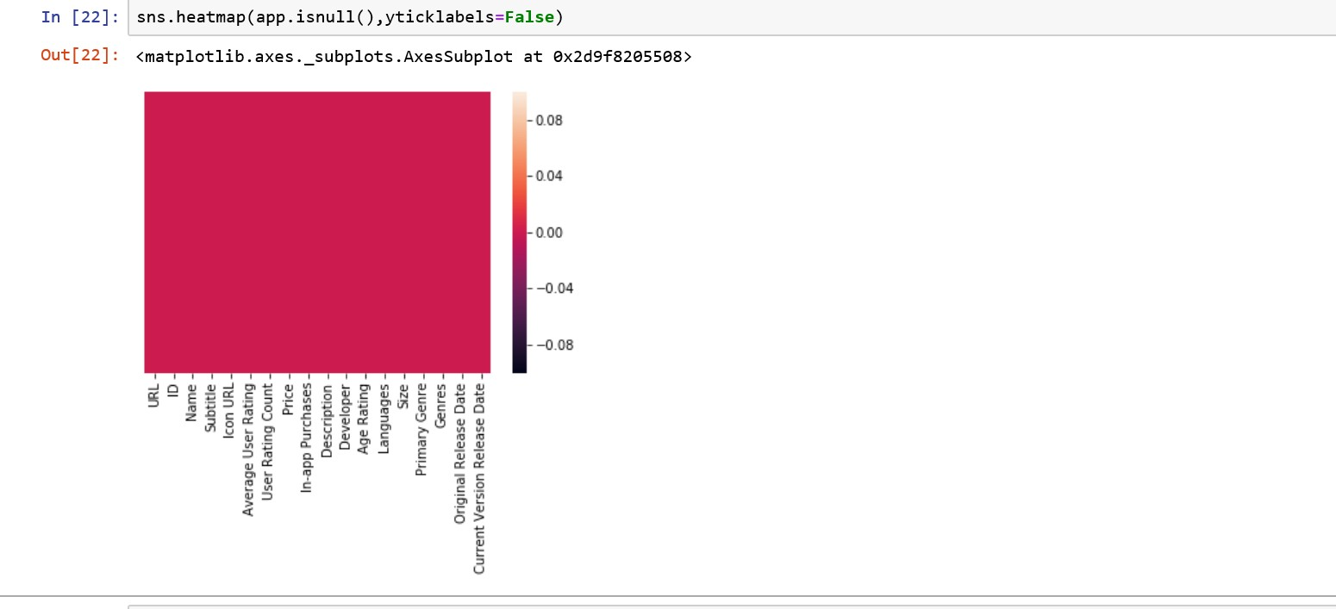
The color of the plot indicates that there are no na values in the dataset

Slide 17
GRAPH VISUALIZATION
We plot different columns of the dataset, so that we can try to analyse some things about the dataset.
R studio has also been used to plot some graphs.

Slide 18
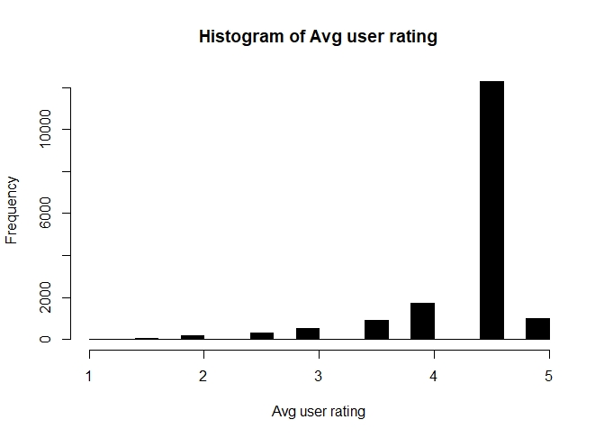
Histogram
Average user rating count v/s Frequency

Slide 19
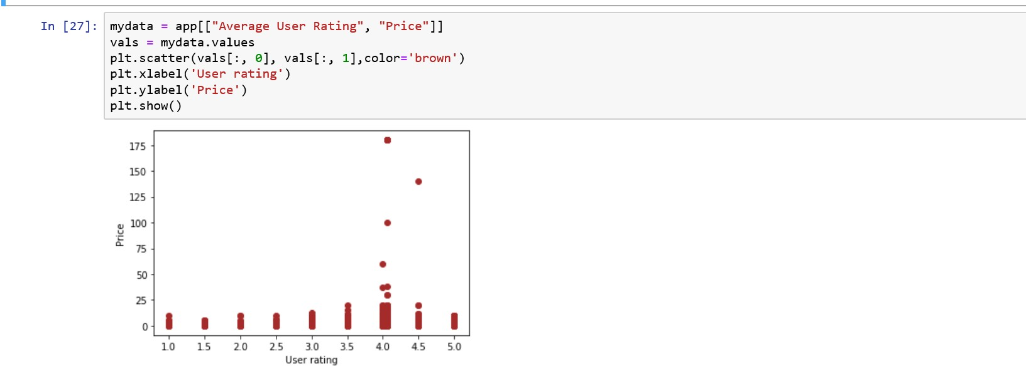
Scatterplot
Average user rating count v/s Price

Slide 20
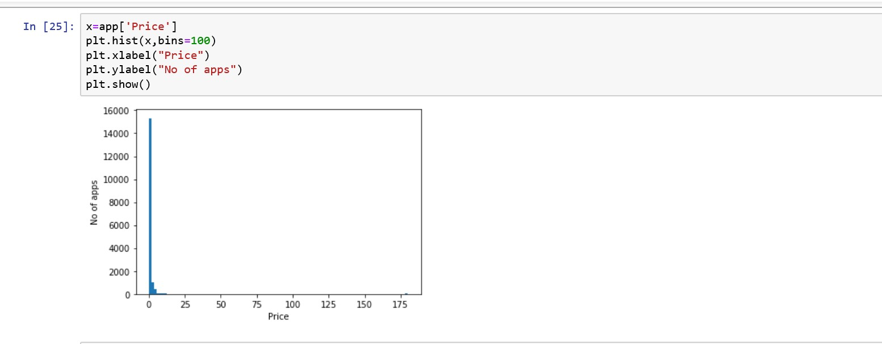
Histogram
Price v/s Frequency

Slide 21
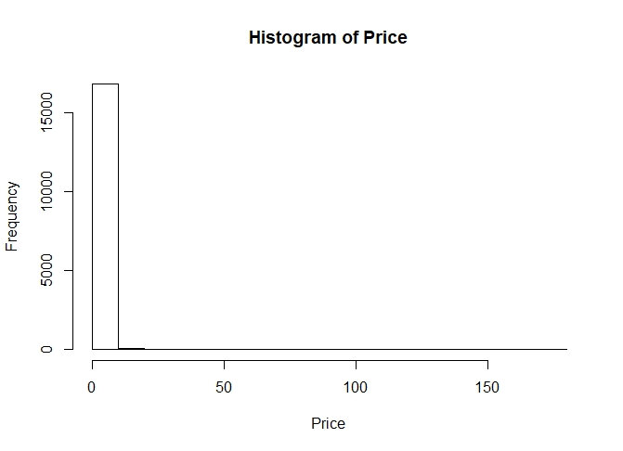
Histogram for Price

Slide 22
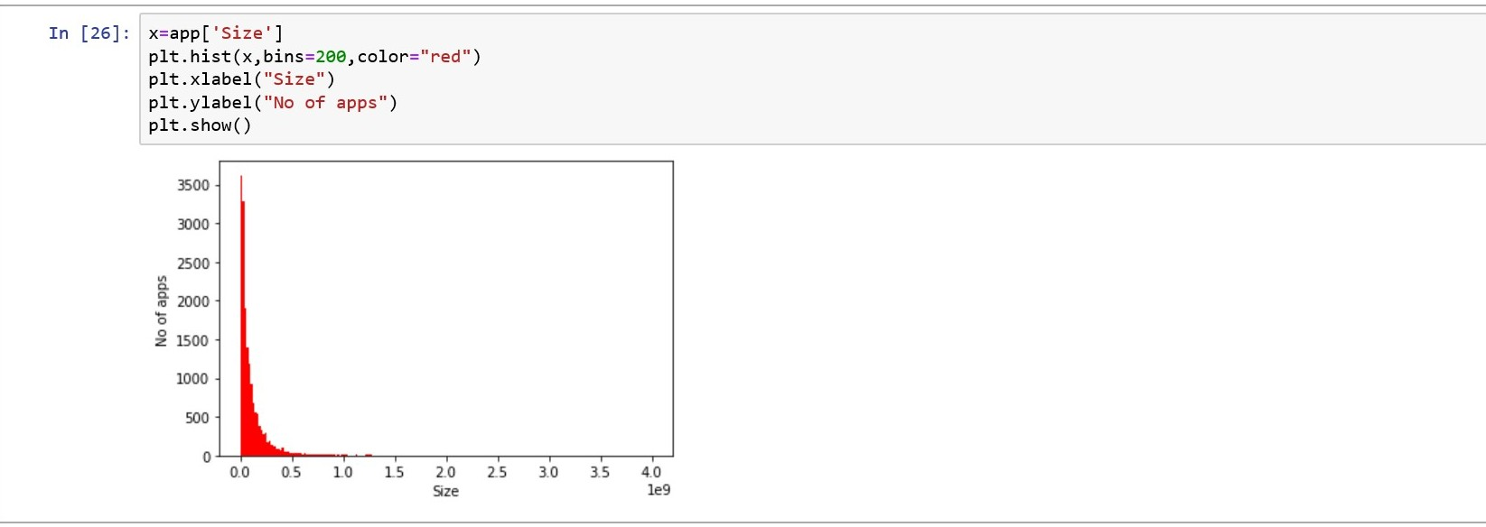
Histogram
Size v/s Frequency

Slide 23
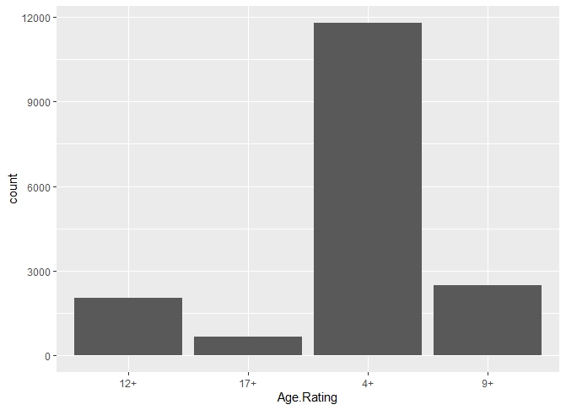
Histogram
Age v/s Frequency

Slide 24
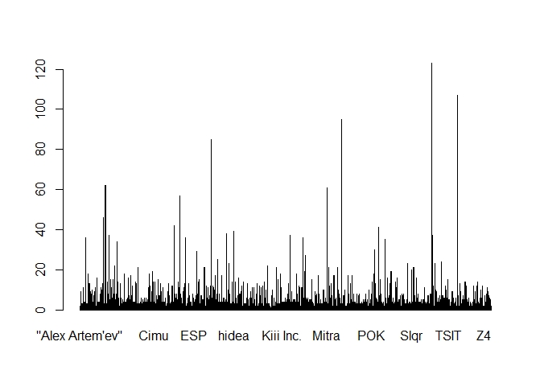
Histogram for different developers

Slide 25
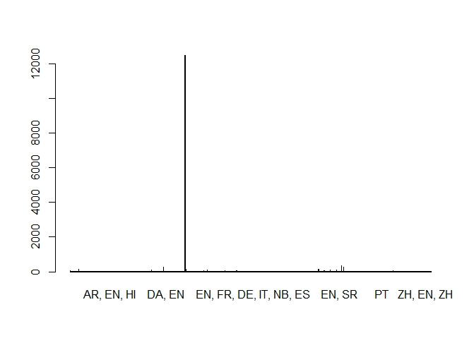
Histogram
Language v/s frequency

Slide 26
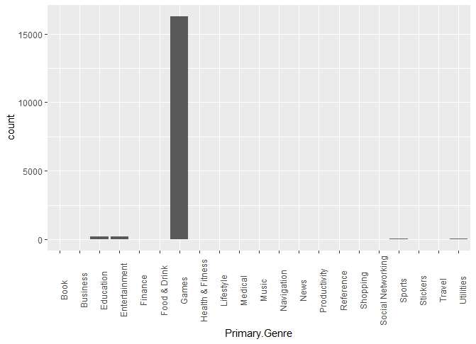
Histogram
Genre v/s frequency

Slide 27
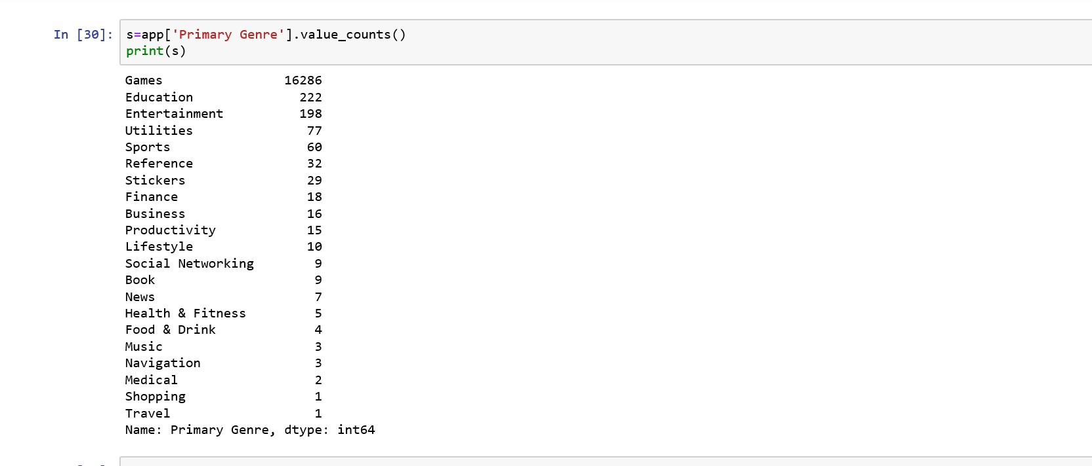
PIE CHART

Slide 28
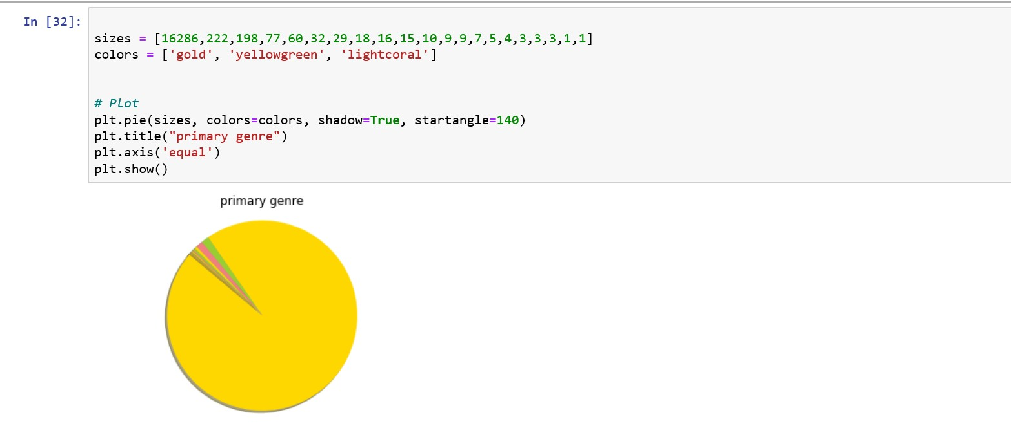

Slide 29
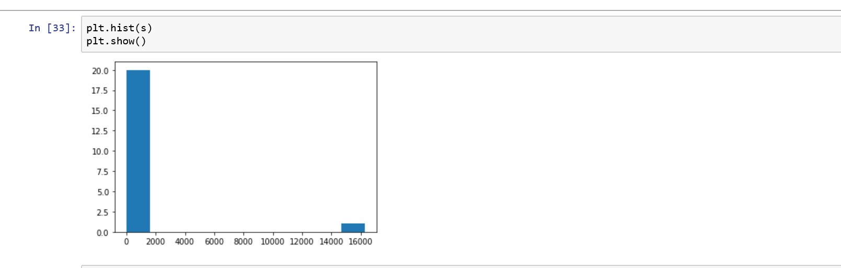
HISTOGRAM

Slide 30
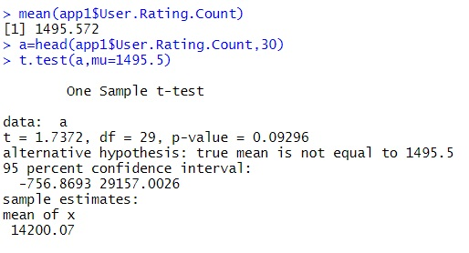
HYPOTHESIS TESTING
User Rating Count
Null hypothesis : population mean=1495.572
Alternate hypothesis : population mean != 1495.572
From this we reject null hypothesis and conclude that alternate hypothesis is true.
Therefore population mean is not equal to 1495.572

Slide 31
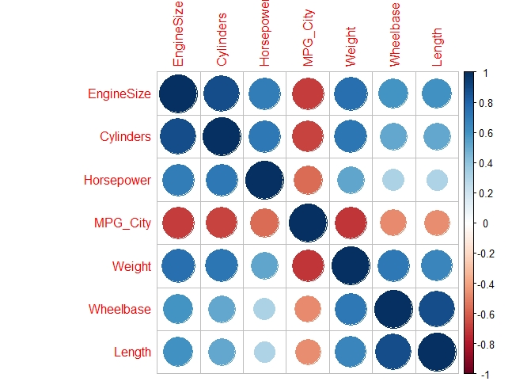
CORRELATION
CORRELATION determines how one variable moves/changes in relation with the other variable. It describes the association with different variables.

Slide 32
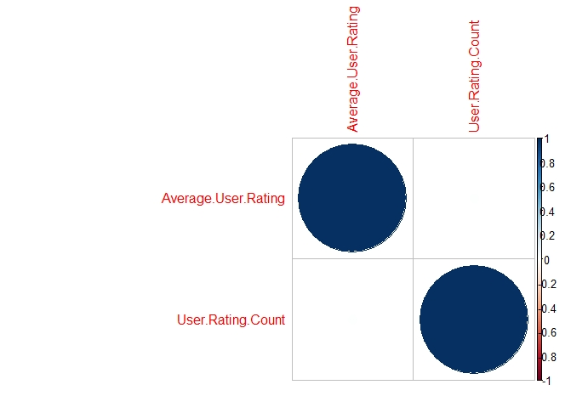
CORRELATION

Slide 33
ANALYSIS
In the histogram of Average user rating count v/s frequency, we can see that in 17000 games, most of the games have a rating between 4 and 5.
In the scatterplot some games that have user rating count of 4 have high price. But most of the games are free of cost.
In the histogram of age rating we can see that most games are allowed to people of age more than 4 but some games are allowed only at specific ages.
Some developers have created more than one or two games.
The preferable language for most of the games is English.
In the plot of genre most games are of just gaming purpose but only some games are of education purpose.

Slide 34
THANKYOU
PES1201801468 - Shriya Raikar
PES1201801979- Pallavi S Murthy
PES1201802033 - Yukthi G L

